Slide 1


Session 3
Privacy and Threat Modeling

Slide 2
Topics for the session
Content Warning
Balancing safety and power
The rest of the four steps.

Slide 3
Change
Check in with yourself
Get Information
Setting Goals
Risks
Today we’re going to do the ‘risks’ part of the process, but we’ve going to do some background on that first…

Slide 4

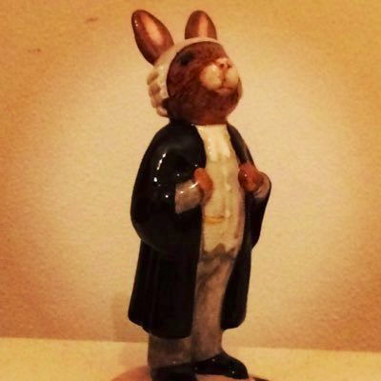
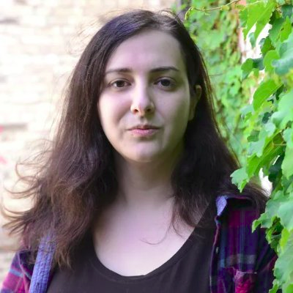
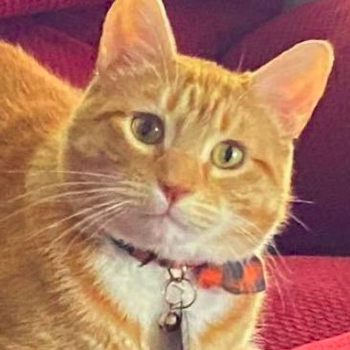
Here are some people
Secret Barrister
Legal reform campaigner
Half a million followers
Identity secret. Claims to be practicing barrister.
Jorts the Cat
Campaigns for unionistation, particularly at Starbucks and Amazon
Quarter of a million followers
Is a cat
Jack Monroe
Anti-poverty campaigner
Half a million followers.
Shares detailed accounts of everyday struggles and trauma.
‘Keffles’
Streamer
50,000 twitch followers
transgender activist

Slide 5
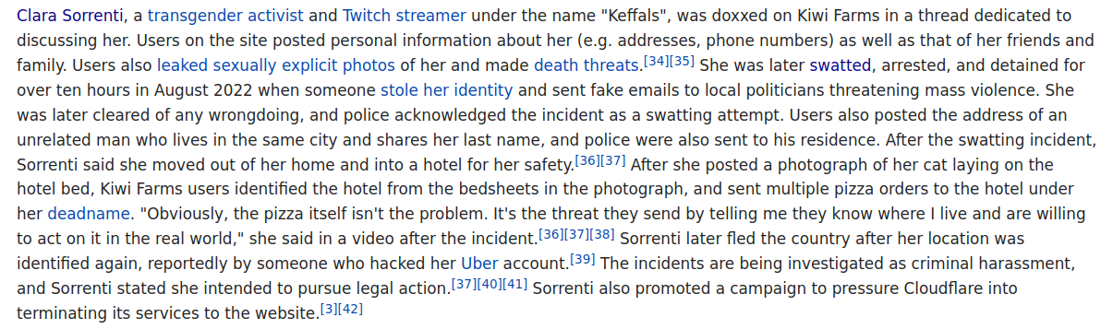
From wikipedia

Slide 6
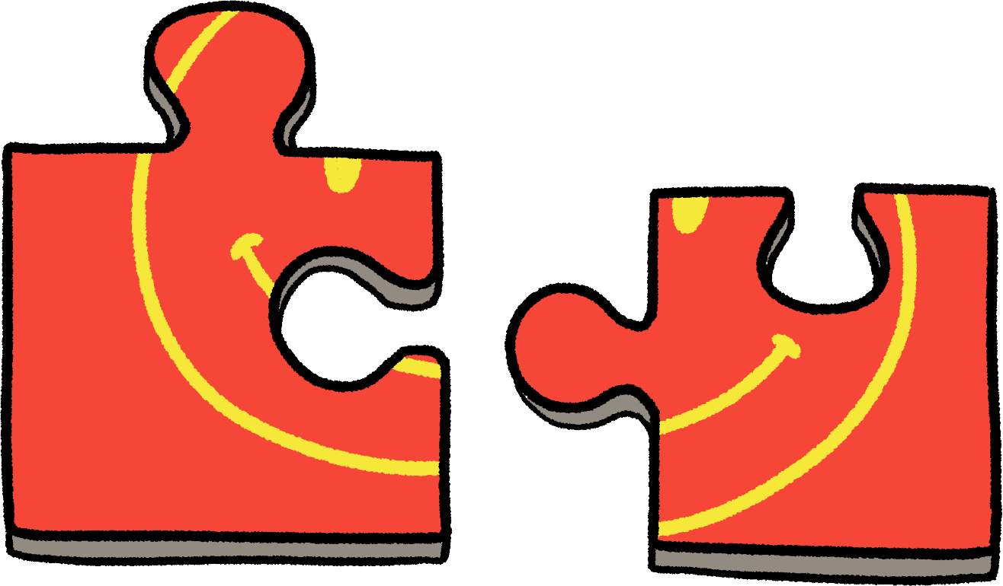
Jigsaw attack
A jigsaw attack is when two or more bits of information aren’t identifying on their own, but are in combination.
“I have to leave at 08:30 to get here”
“I saw a guy on my bus today…”
“My favourite thing is drinking hot chocolate looking at the rain out of the attic windows.”

Slide 7
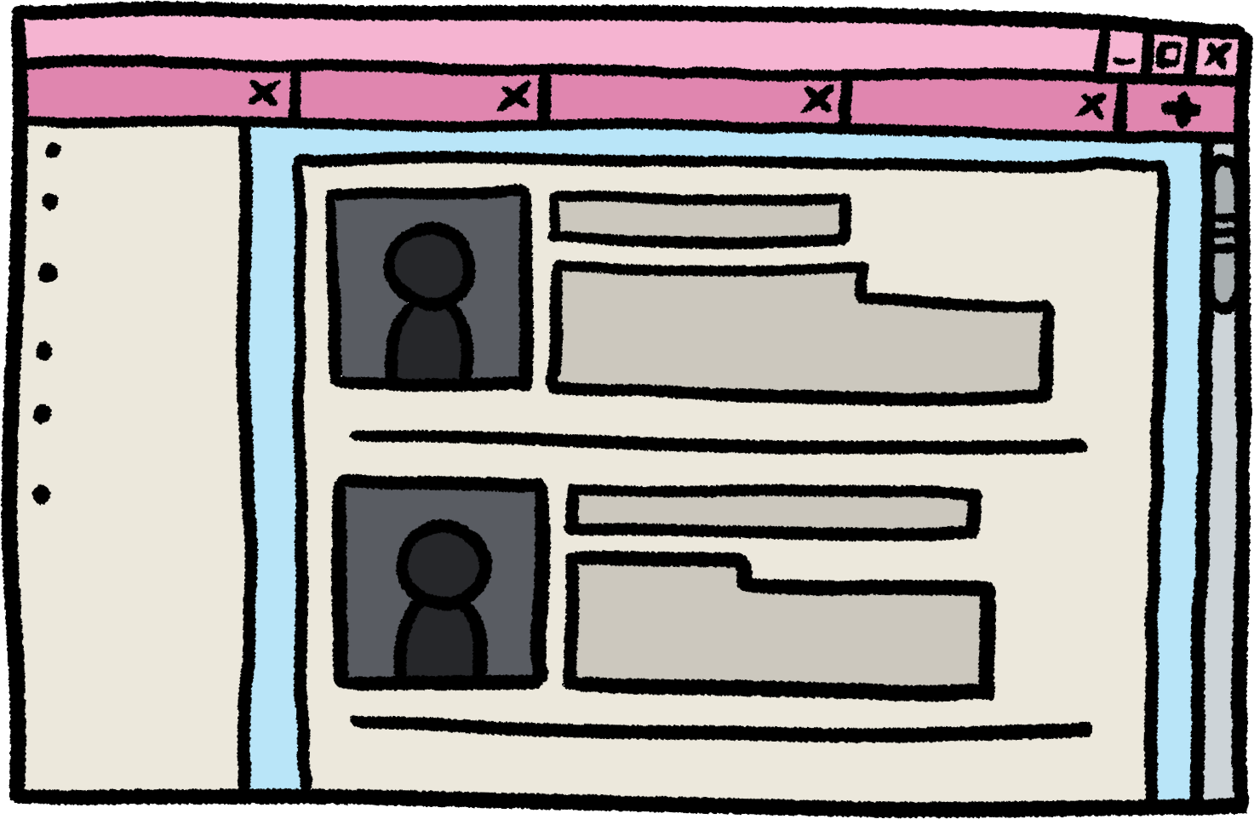
Sometimes you don’t need a jigsaw attack
If you are registered to vote then your name and address are available on the electoral roll.

Slide 8
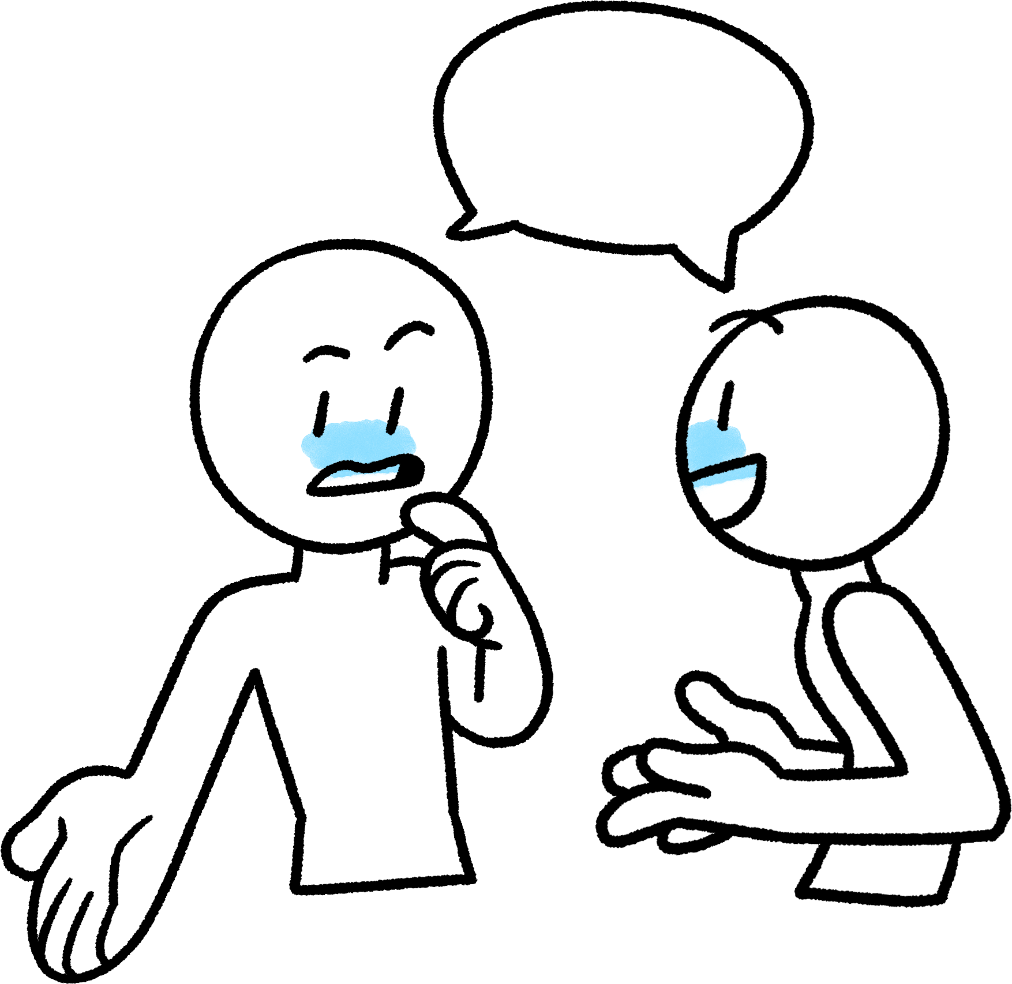
Where are we so far
Some very scary things can happen.
It would be great to have a language for talking about threats and risks and likelihoods.
Fortunately we’re going to learn some.

Slide 9
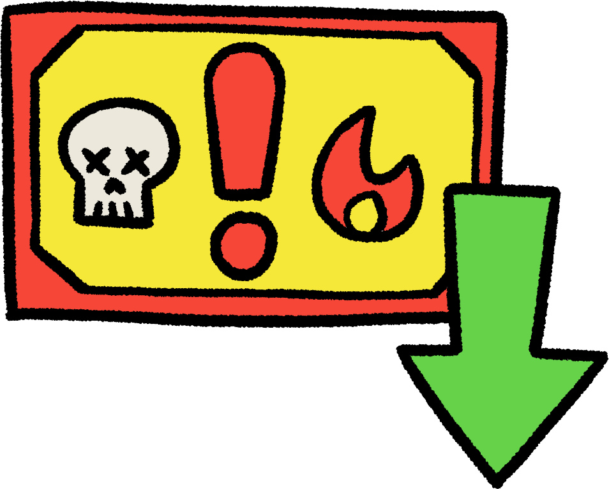
Threat Modelling
By the end of this course you will be able to do a full threat model for social change projects (and other projects)
Lots of different official methods:
STRIDE
P.A.S.T.A
VAST
We’re going to it as a risk assessment because:
It’s simple and understandable
The others are designed for very big IT projects and cybersecurity teams

Slide 10
Threat Modelling
For a support group for people who have been assaulted in the local area.
Threat | Damage | Likelihood | Total Risk | Action taken | Revised Risk
Accidental release of chat logs | 3(high) | 3(likely) | 9(unacceptable) | Move to a chat platform that didn’t record logs or allow screenshots | 0 (zero)
Accusations of interfering with criminal process | 3(high) | 1(unlikely) | 3(reasonable) | Train members in proper guidance on how to support someone who has recently been the victim of a crime | 3(reasonable)

Slide 11

Threat Modelling
Pick one of the causes we identified in the last session and ask these questions:
Attackers
Who would like to stop you?
Who stands to gain if you fail?
What other ways might someone attack?
Assets
What information do you need to work?
Who else is it valuable to?
When can you share it?

